Slide 1
Informed /Heuristic Search

Slide 2
Informed search
Uses problem-specific knowledge beyond the definition of the problem itself
Can find solutions more efficiently than an uninformed strategy.
Expand closer-seeming nodes first

Slide 3
Heuristics
Key notion: heuristic function h(n) gives an estimate of the distance from n to the goal
h(n)=0 for goal nodes
E.g. straight-line distance for traveling problem
2
C
B
9
2
3
goal state
F
start state
A
E
3
D
4
4
Say: h(A) = 9, h(B) = 8, h(C) = 9, h(D) = 6, h(E) = 3, h(F) = 0
We’re adding something new to the problem!
Can use heuristic to decide which nodes to expand first

Slide 4
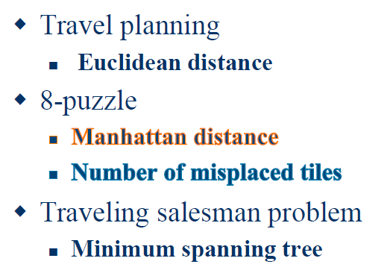
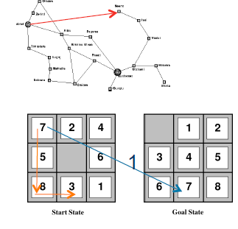
Examples - Heuristics

Slide 5
Best First Search
Best-first search is an instance of the general TREE-SEARCH or GRAPH-SEARCH algorithm in which a node is selected for expansion based on an evaluation function, f (n)
Best-first search can be implemented within our general search framework via a priority queue, a data structure that will maintain the fringe in ascending order of f -values.
If the evaluation function is exactly accurate, then this will indeed be the best node

Slide 6
Best First Search
There is a whole family of BEST-FIRST-SEARCH algorithms with different evaluation functions.
A key component of these algorithms is a heuristic function h(n)
h(n) = estimated cost of the cheapest path from node n to a goal node
Heuristic functions are the most common form in which additional knowledge of the problem is imparted to the search algorithm
if n is a goal node, then h(n) = 0.

Slide 7
Greedy best-first search
Thus, it evaluates nodes by using just the heuristic function: f (n) = h(n).
Greedy best-first search: expand nodes with lowest h values first
state = A,
cost = 0, h = 9
state = B,
cost = 3, h = 8
state = D,
cost = 3, h = 6
state = E,
cost = 7, h = 3
state = F,
cost = 11, h = 0
goal state!
Rapidly finds the optimal solution!
Does it always?

Slide 8
A simplified road map of part of Romania.

Slide 9
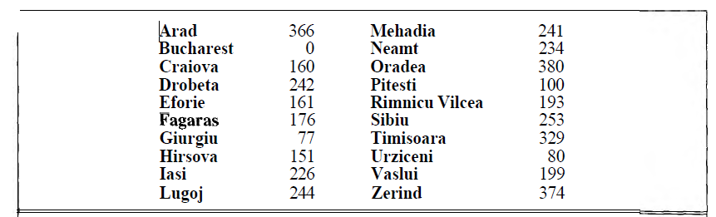

Slide 10
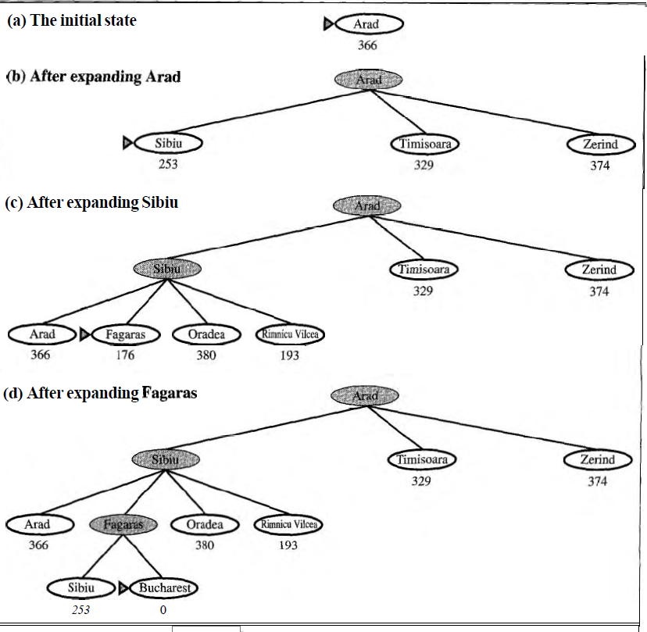

Slide 11
A* search: Minimizing the total estimated solution cost
The most widely-known form of best-first search is called A* search
It evaluates nodes by combining g(n),the cost to reach the node, and h(n.),the cost to get from the node to the goal
f(n)=g(n)+h(n)
g(n) → gives the path cost from the start node to node n, and
h(n) → the estimated cost of the cheapest path from n to the goal,

Slide 12
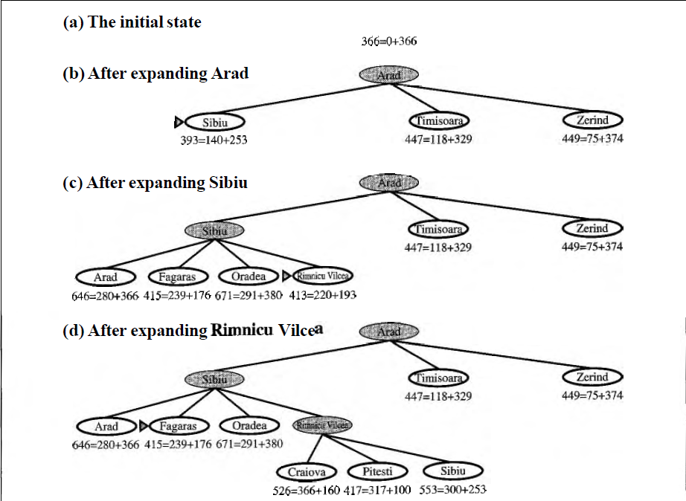

Slide 13
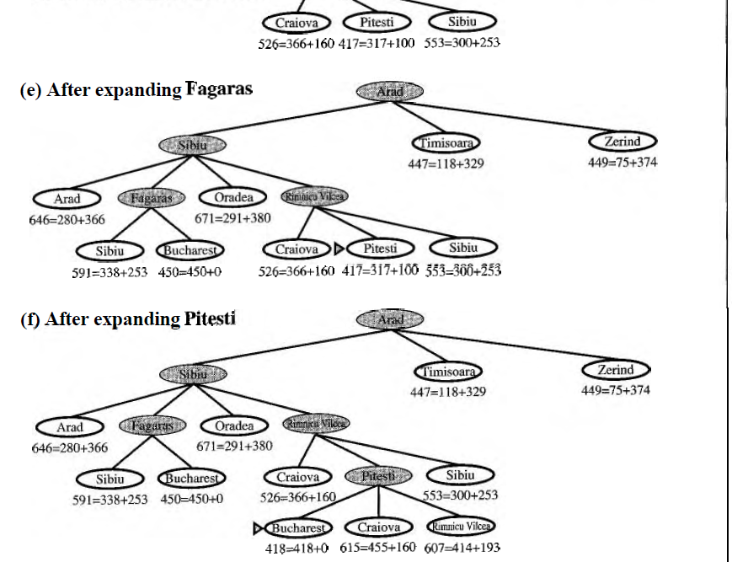

Slide 14
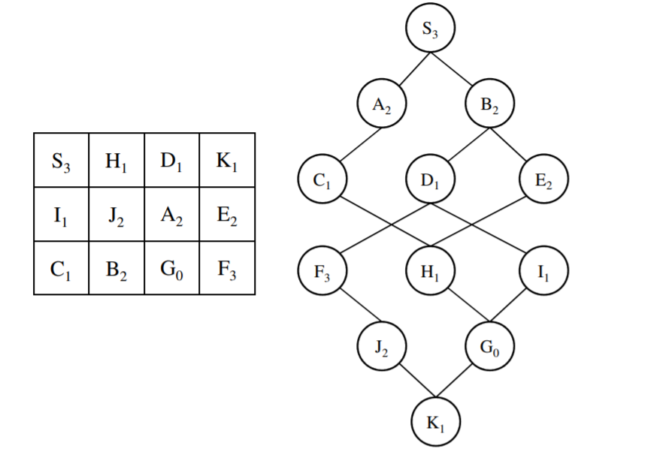
Example
Depth-first search.
S A C H E B D F J K G
Breadth-first search.
S A B C D E H F I G
S (0+3=3), A (1+2=3), B (1+2=3), C (2+1=3), D (2+1=3), E (2+2=4), H (3+1=4), G (4+0=4)
A*
The letter in each node is its name and the subscript digit is the heuristic value. All transitions have cost 1.

Slide 15
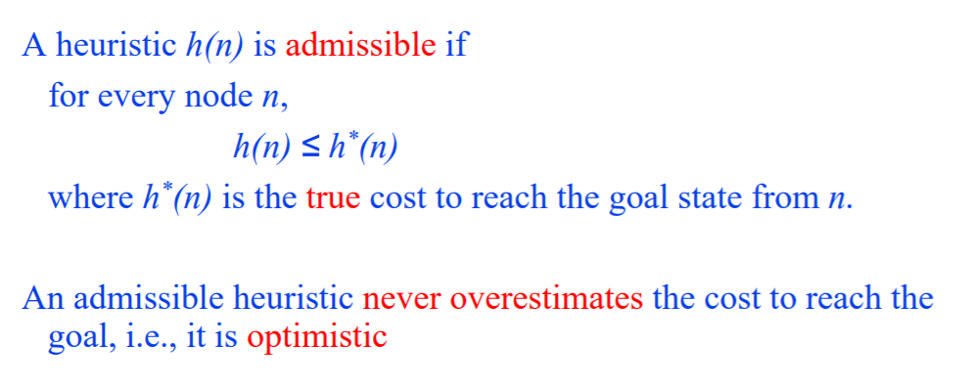
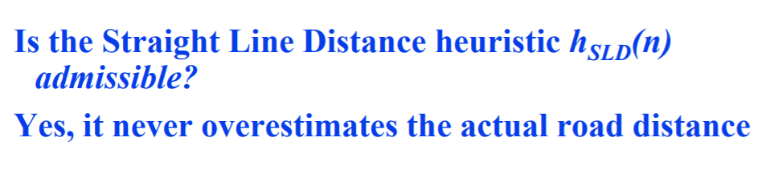
Admissible heuristics

Slide 16
Admissibility
A heuristic is admissible if it never overestimates the distance to the goal. i.e, If n is the optimal solution reachable from n’,
then g(n) ≥ g(n’) + h(n’)
A* is admissible if it uses an admissible heuristic, and h(goal) = 0.

Slide 17
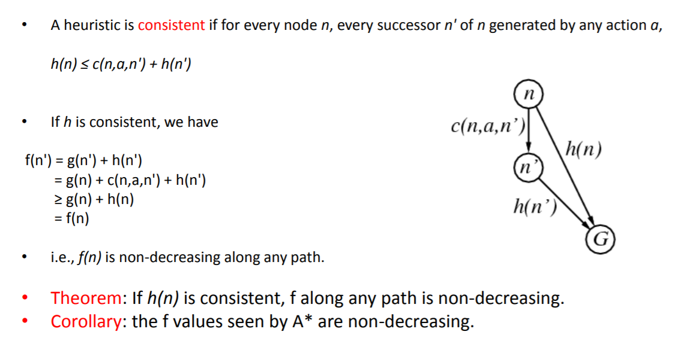
Consistent (monotone) Heuristics

Slide 18
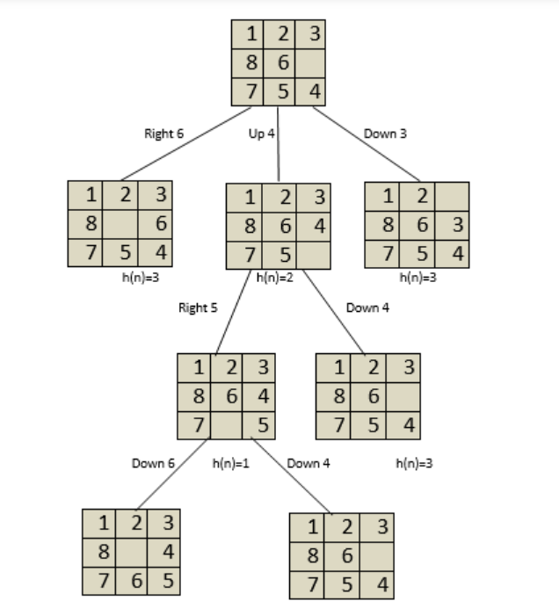
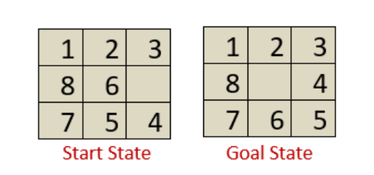

Sample Heuristic functions
h(n)=Number of tiles out of position.
h(n)=3

Slide 19
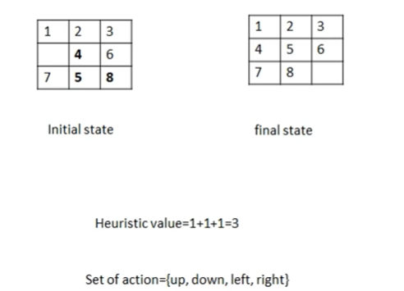

Slide 20
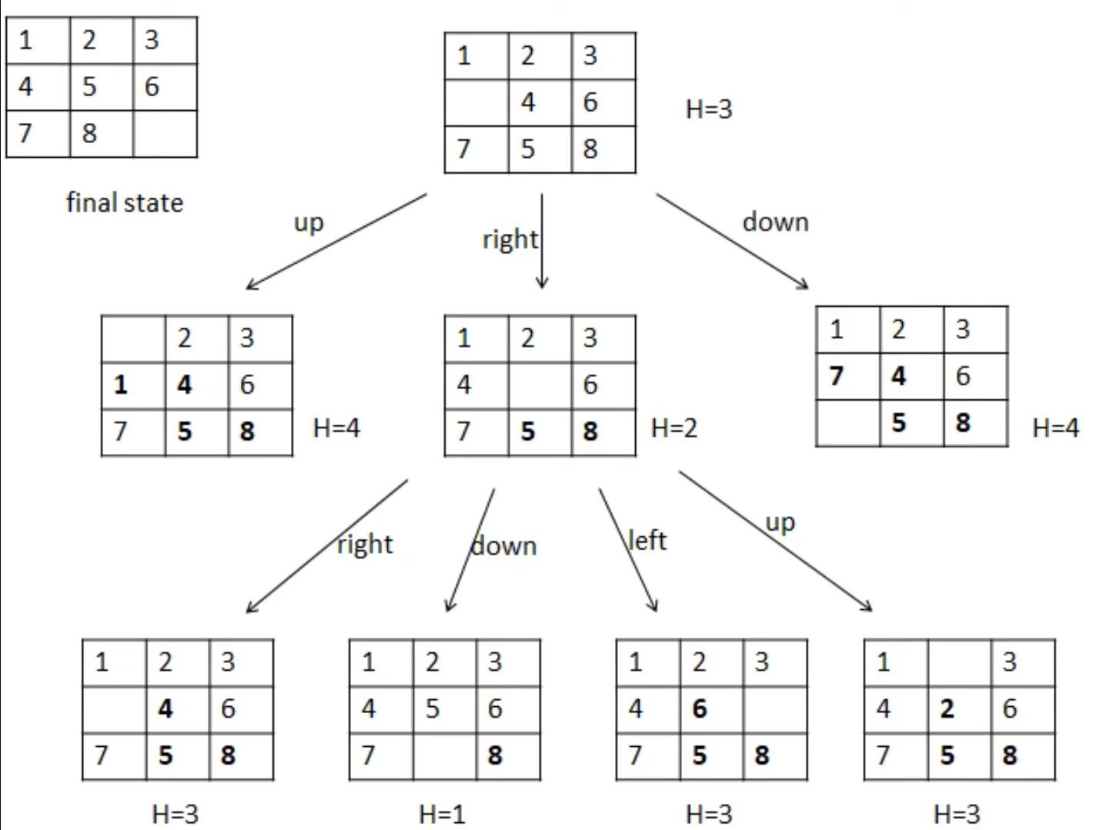

Slide 21
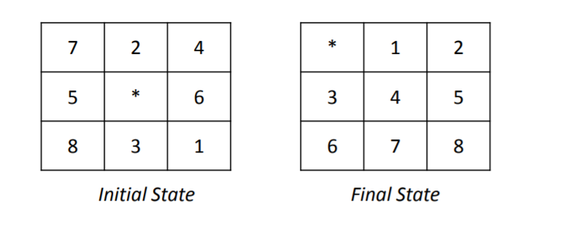
H1 : Number of misplaced tiles
H2: Sum of Eucledian distances of the tiles from their goal positions
H3 : Sum of Manhattan distances of the tiles from their goal positions

Slide 22
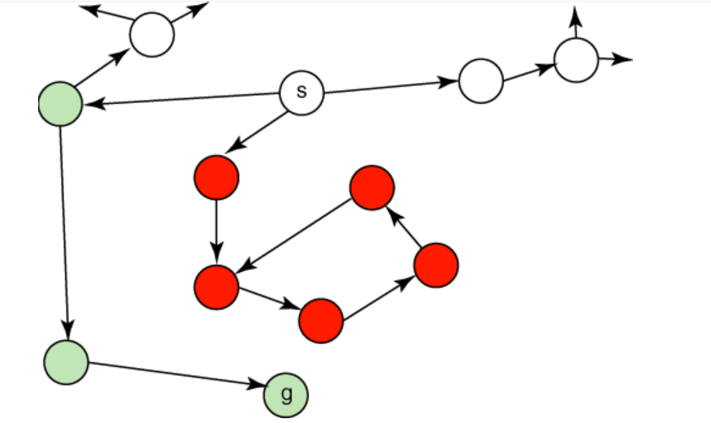
A graph that is bad for best-first search

Slide 23
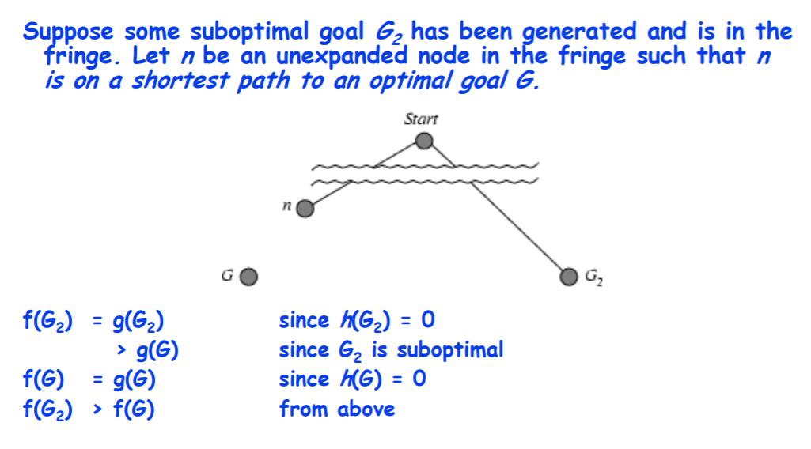
Properties of A*

Slide 24
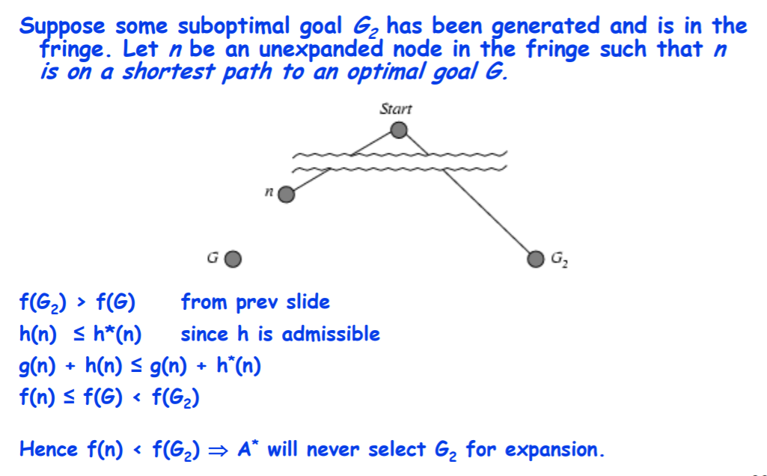

Slide 25
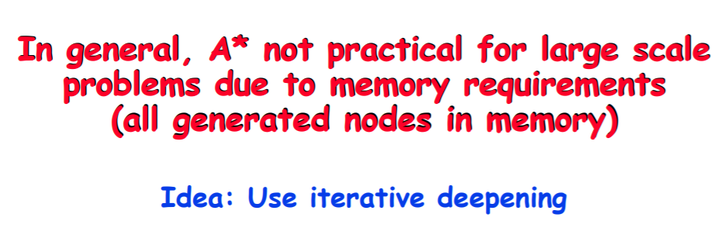
Properties of A*
Complete?
Yes, (unless there are infinitely many nodes with f<=f(G)
Time? Exponential (Worst case all the nodes are added)
Space ? Keeps all nodes in memory
Optimal?

